Slide 1


Transforming Automobile Insurance Claims through GenAI
Team AI & Team Data | 3rd September, 2024
Sprint 3 - Week 7

Slide 2

Agenda
1
Completed Tasks
Slides 3 — 9
2
Development Pipeline
Slides 10 — 13
3
Future Tasks Slide 14 — 16
4
Roadblocks Slide 17 — 19
5

Slide 3

1
Completed Tasks
‹#›

Slide 4
Completed Tasks - Data Team
Data Team Noorullah & Adam’s Completed Tasks
Team AI Tasks
Found 3 Good Datasets and Mapped out Data Sets
Prepared Original Datasets
Generated 3000 rows of Data using Statistical Sampling
Arranged our Code and Datasets in Folders
Statistical analysis between columns on Dataset 1
Helped Cleaning and Enriching Dataset 1
Made a Correlation Matrix & Anova Test on Dataset 1
Cleaned and Enriched Dataset 2
Cleaned, Augmented & Generated Columns
Ran a statistical analysis to find the distribution of vehicle age
Updated Data Flow Diagram
Separated the cleaning and enriching scripts
Planned current & future developmental Sprints and Epics
Split Fraud & Non - Fraud Data
Found 3 Good Datasets and Mapped out Data Sets
Fully Cleaned and Enriched Dataset 1
Helped Clean & Enrich Dataset 2
Loaded Code and data files to Google Drive
Notes:
Noorullah & Adam

Slide 5
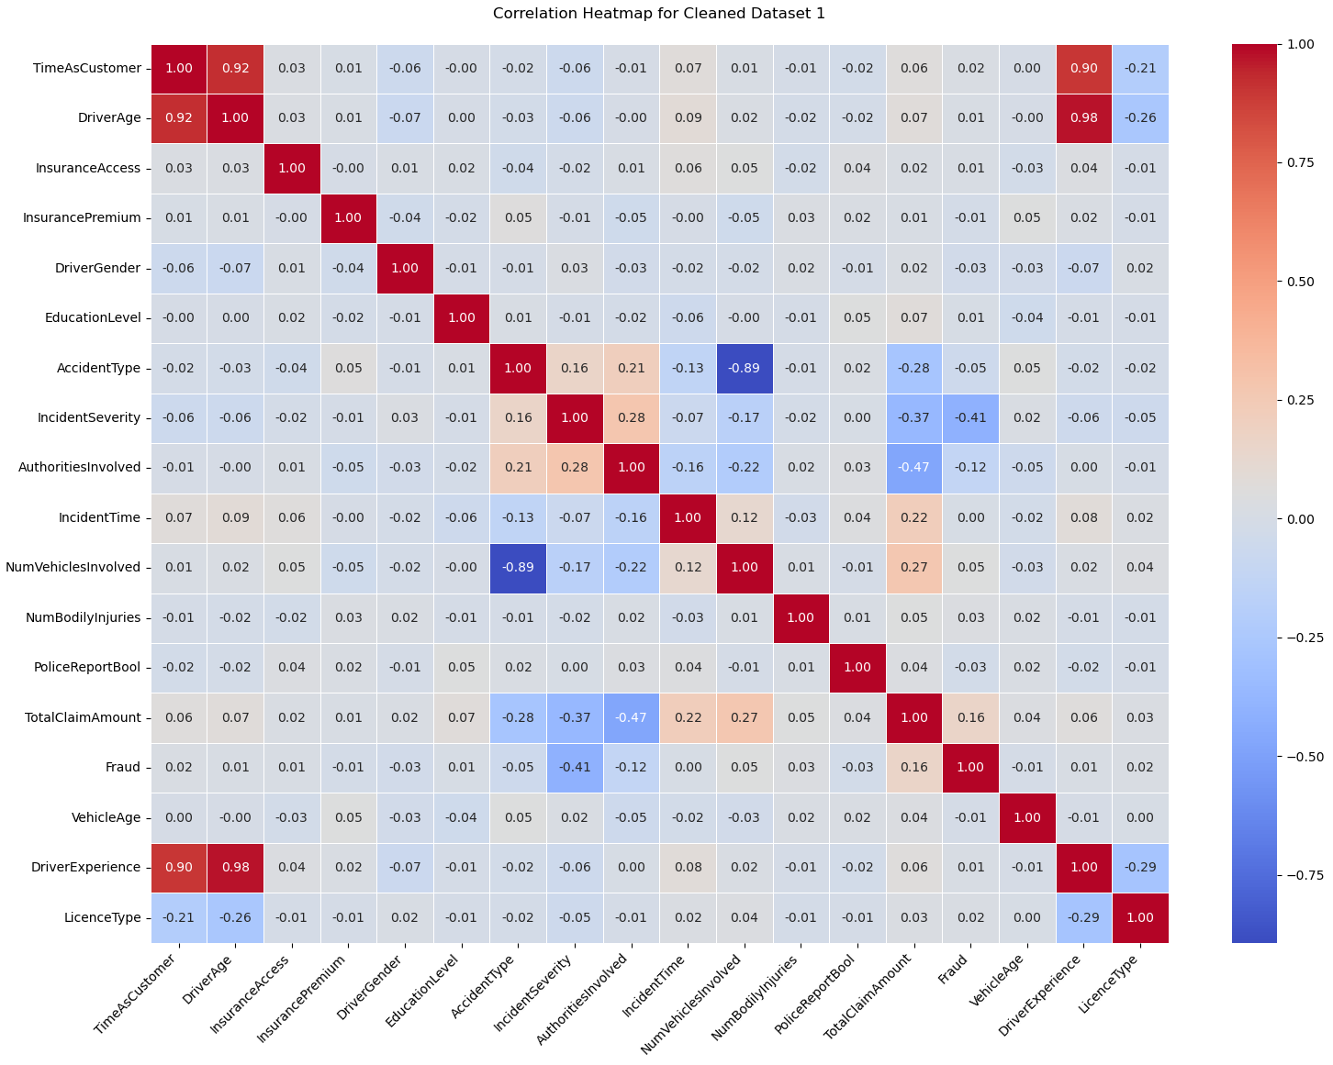
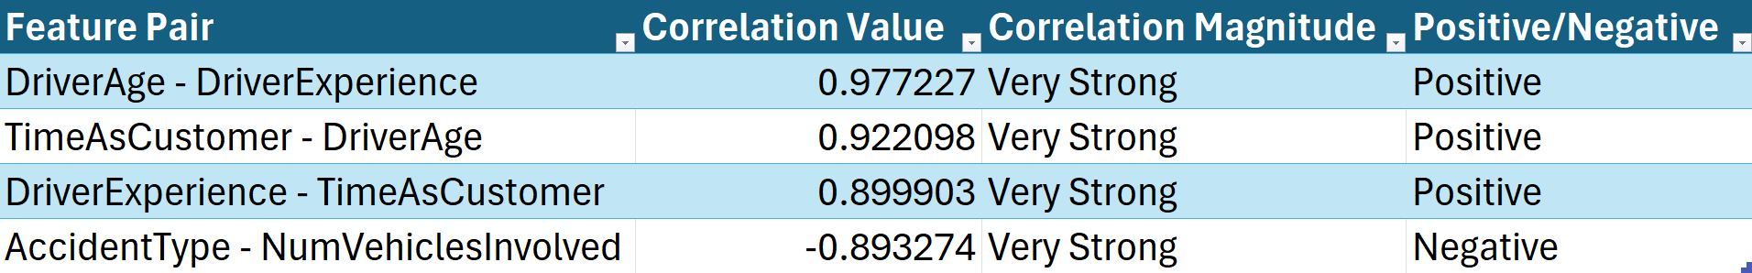
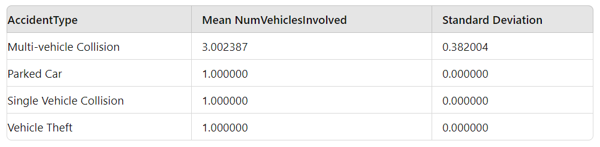
Correlation Matrix
Significant correlations (absolute value > 0.7):
AccidentType statistics for NumVehiclesInvolved

Slide 6
Completed Tasks - Data Team
Data Team Tash, Ninuri & Alan’s Completed Tasks
Team AI Tasks
Finalised formatting and editing of Deliverable 2
Created MVP proposition
Submitted Deliverable 2
Infrastructure is fully on Terraform (v.4.0.1)
Created 25 Technical User Stories based on mentor feedback
Deployed test functions on Azure (personal account)
Created 25 Business User Stories based on mentor feedback
Sent final options analysis and MVP Proposition
Research on imputation methods of categorical missing values
Research on imputation methods of numerical missing values
Notes:
Data team - Tash & Alan
2-3 points
2 points

Slide 7
Completed Tasks - AI Team
AI Team’s Completed Tasks - Dan, Eugene, Ngoc
Team AI Tasks
Handed in Deliverable 2
Created Azure accounts for testing
Familiarised Azure AI Studio
Linked GPT-4o-mini to Azure
Explored relevant Azure functions
Uploaded data source to AI model
Finalised the combined Option analysis
Notes:
Data team - Alan
Ai team - Eugene

Slide 8
Completed Tasks - AI Team
AI Team’s Completed Tasks - Mingxin and Akriti
Team AI Tasks
Finalised and formatted Deliverable 2
Familiarised and researched about Azure Studios
Understanding the comprehensive data set being used
Finalised and finished all the work on Option Analysis
Consistently implement risk management in AI models
Notes:
Data team - Alan
Ai team - Eugene

Slide 9
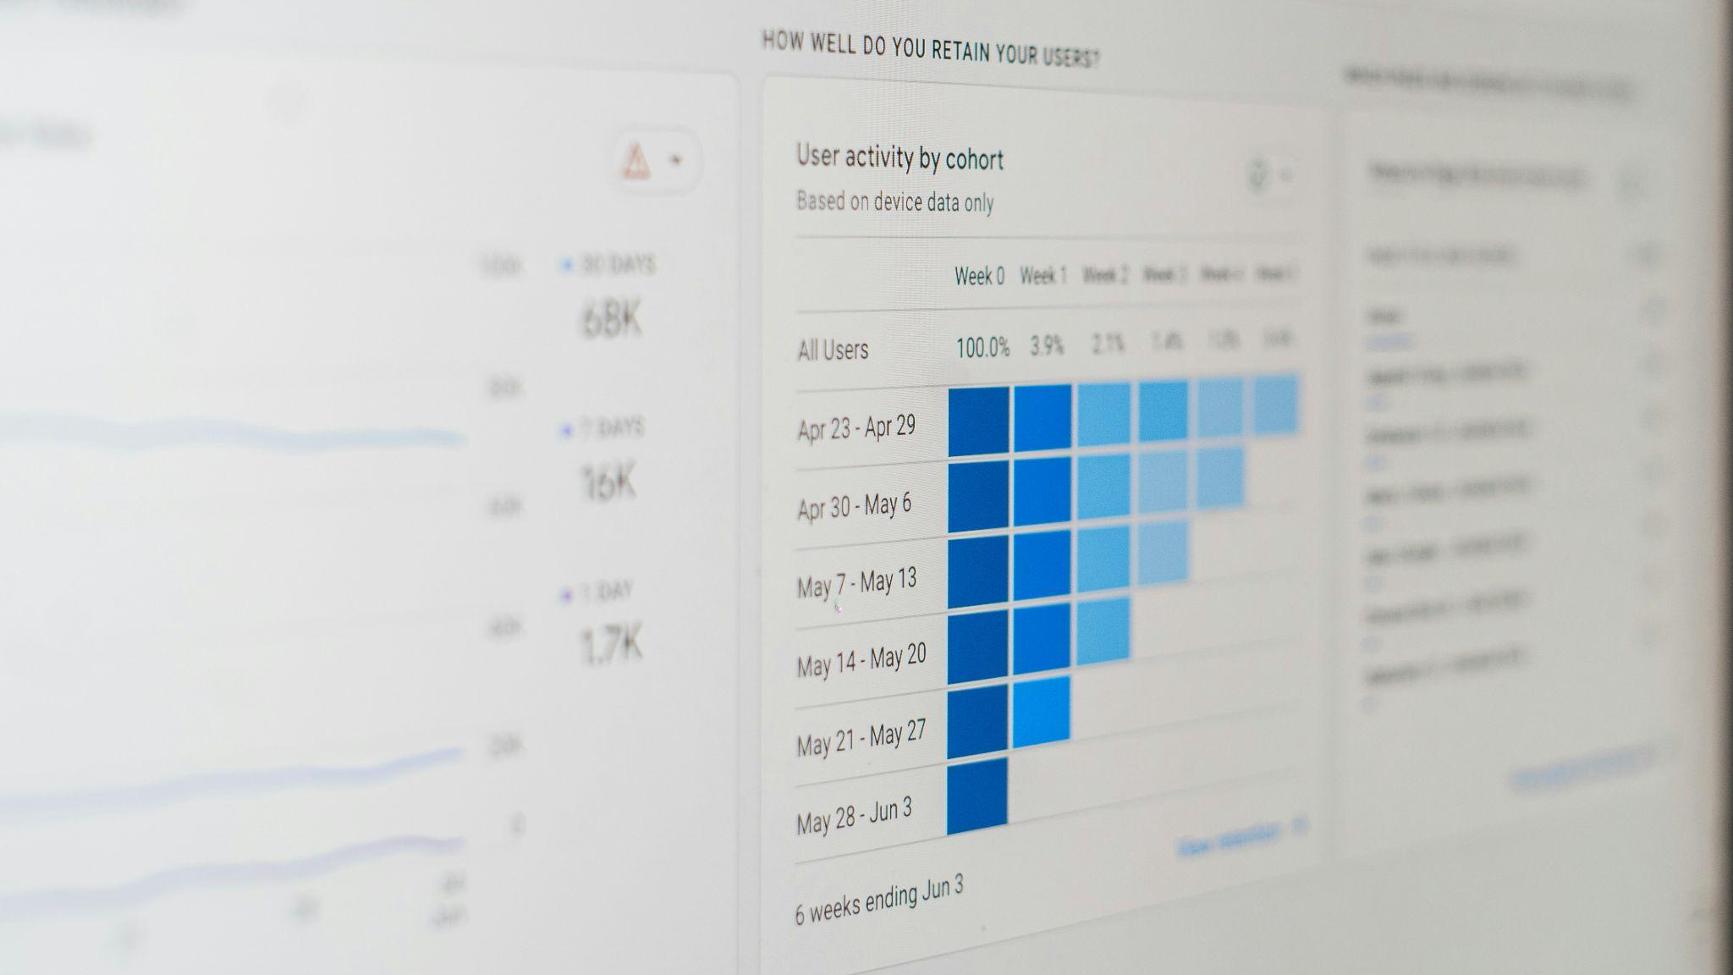
2
Development Pipeline
‹#›

Slide 10
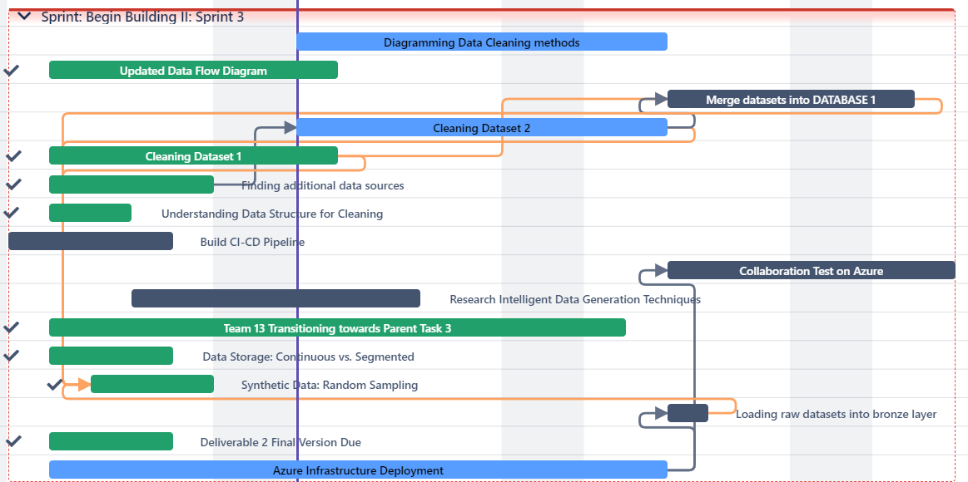
Sprint 3: Gantt Chart
Notes:
Data team - Noor
Ai - Eugene

Slide 11
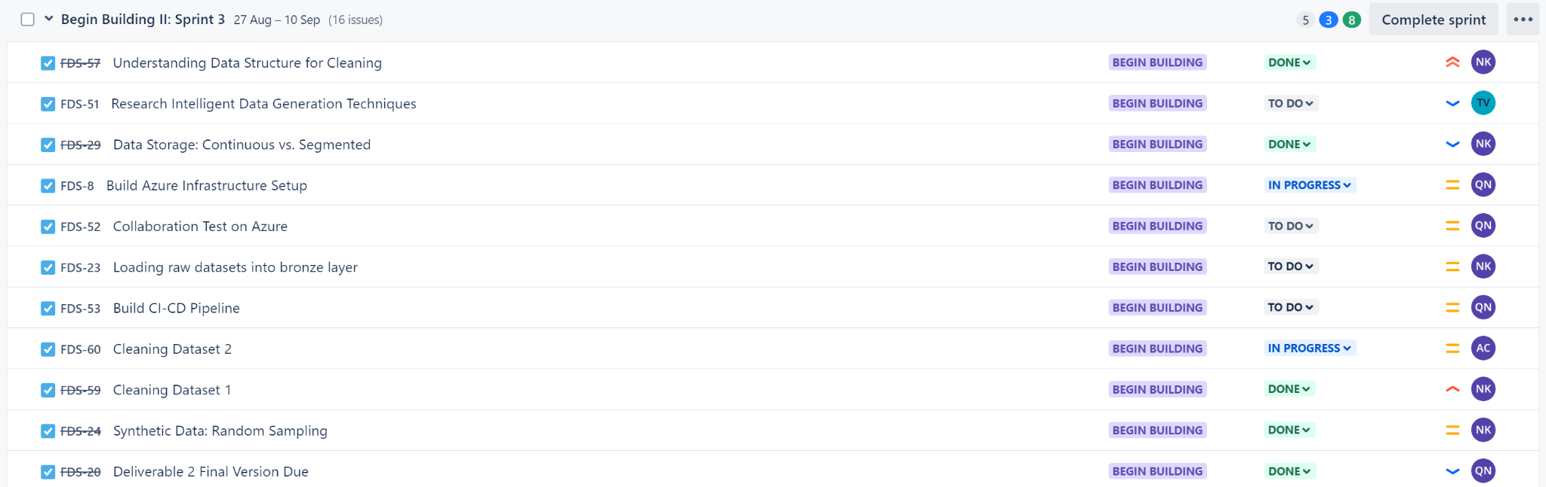
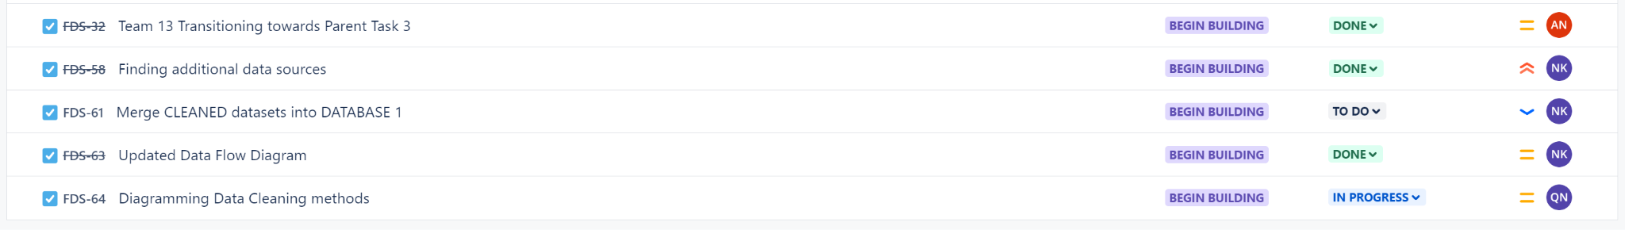
Sprint 3: Tasks Backlog
Notes:
Data team - Noor
Ai - Eugene

Slide 12
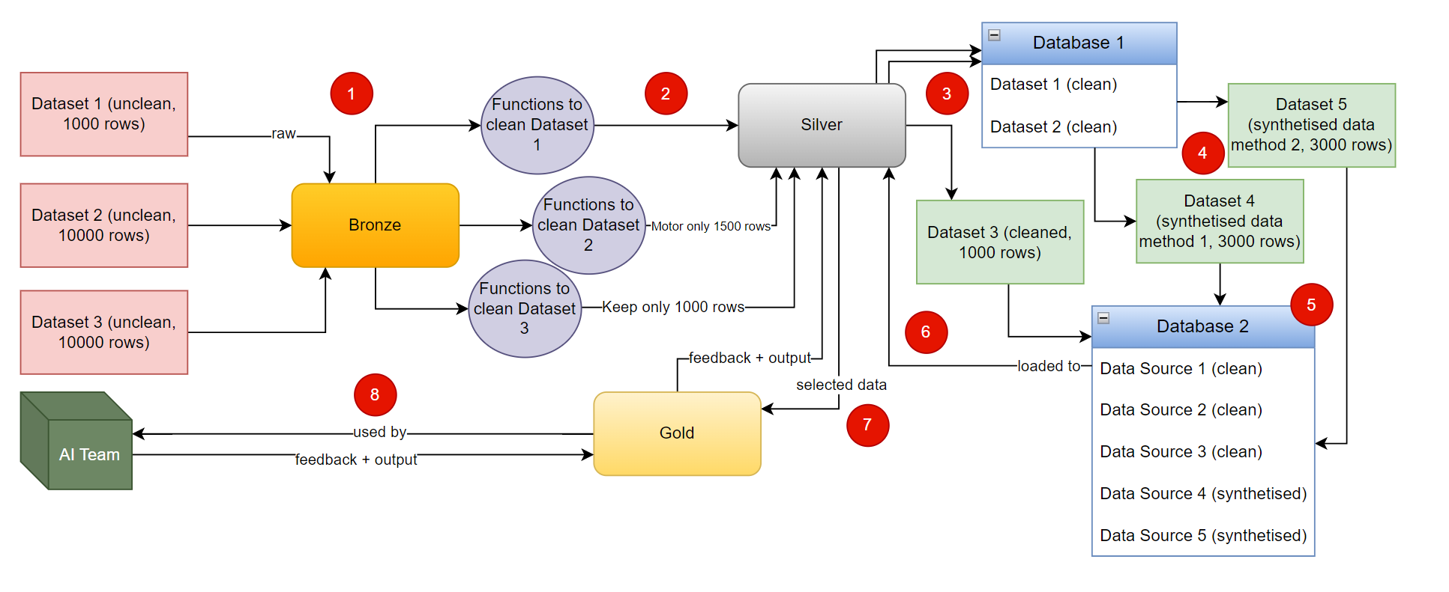
Updated Data Pipeline Diagram - Data Team
Notes:
Data team - Noor
Load (raw) Data into Bronze
Clean Data then send to Silver
Create More Data (from Silver Data)
Combine All Data then send back to Silver
Move Relevant Metadata to Gold
Send Gold Database to AI Team
Have Feedback + Output Loop between AI Team & Gold AND Gold & Silver Layers

Slide 13

3
Future Tasks
‹#›
Notes:
Data - Adam

Slide 14

Upcoming Tasks - Data Team
Data Team’s Upcoming Tasks
Team AI Tasks
Refine Data Synthesising Process
Merge dataset 1 and dataset 2 into database 1
Think of new ways to synthesise higher quality data
Synthesize data instead on combined database 1
Begin loading raw files onto Azure *
Start migrating our code to work on azure functions
Impute missing numerical values using support vector regression (SVR)
Impute missing categorical values using the random forest method
Automate Terraform and Azure Functions with Github actions
Dataset 3 cleaning and enriching
Notes:
Data team - Alan

Slide 15






Upcoming Tasks - AI Team
Conducting 50 data row tests
Conditioning the system message
Upcoming Tasks
Learning technical components of AI + ML
Integrating LLM into the Playground
The tasks to be completed for the next Sprint Interval
Adjustments to the Options Analysis
Reviewing D2 feedback when available

Slide 16

4
Roadblocks
‹#›

Slide 17
Previous Roadblocks
Roadblocks | Actions Taken
Imputation (put in filler values with no meaning in missing rows) | We are working on imputation methods for categorical and numerical (SVR and Random Forest Classifier)
How to clean data? | Learnt and mapped out the various data sources then made a comprehensive document with the cleaning procedure, methods and strategies.
Methods to synthesise data | Method 1: Data Remapping & Random Sampling Method 2: unclear
Segmented vs Continuous data | Decided to use continuous as our data volume is not too large
Categorical or Numerical data | Converted some columns to booleans and converted all booleans to 1 and 0. Turned columns like gender to numeric. Kept everything well documented.
A payment per model is limited to only one account. | Many accounts can be made in testing.

Slide 18
Roadblocks
❌
Technical issues with Azure
❌
Authorisation problems with Terraform
❌
Require Azure AI Search
Function app not recognising deployed
functions
❌
❌
Pricing
❌
Adding values to Gender column based on Name is inaccurate
❌
Exceeding rate limit with testing accounts
❌
Use of API’s to add Gendering to name is a paid service.
❌
Issues with digesting data
Notes:
Ai - Akriti
Data - Alan

Slide 19
Thank You

